Slide 1
LINK
GROUP
LINK
Automation Engineering (Shanghai) Co.,Ltd.
GROUP
霖和自动化工程(上海)有限公司
Training Record
Pham Tung Lam : PLC Engineer
Phase concept

Slide 2
OVERVIEW PHASES
Resequencing describes a method for bringing system parts that are somewhere in the production process back to a defined state in order to be able to start the machine again. However, this state should not only be an initial state, but there is a modular concept that maps the respective production process and enables synchronization / start-up at all process and process-relevant points.
Phases: The structuring of the production process takes place in so-called phases! The individual phases are therefore synchronization points. This phase-based concept is firmly linked to sequence programming via step chains and also to a resequencing process via step chains. Thus, in principle, resequencing also represents an automatic operating mode.

Slide 3
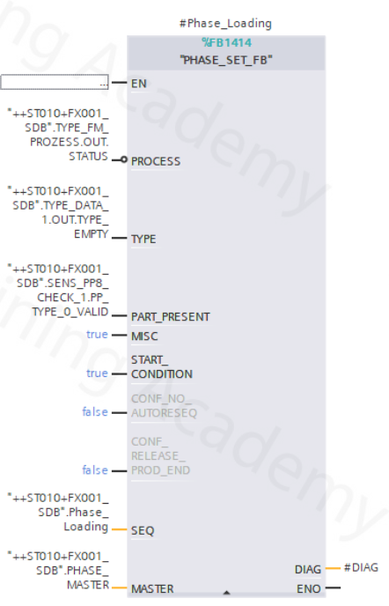
PHASE DEFINITION - DECISION CRITERIA
When restarting, the machine must decide which phase is suitable and also possible for starting as a synchronization point. This is only possible if: PROCESS, TYPE, PART_PRESENT and MISC are fulfilled!
The phase definition must be unique. ALL phases must differ in the definition of PROCESS, TYPE,PART_PRESENT and MISC.

Slide 4
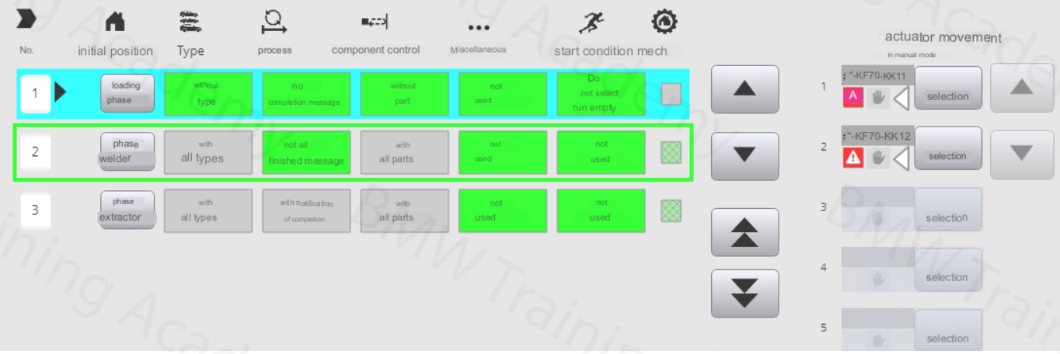
HMI SUPPORT - CONSISTENT PLANT STATUS
The station is in the welding phase (active phase: green frame). If resequencing is now selected, the loading phase is recognized as a consistent phase and resequencing can be started.

Slide 5
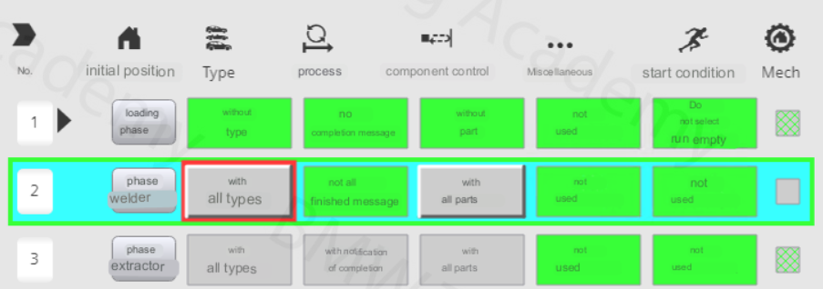
The machine points out the inconsistencies one by one. In this case, a valid type is missing from the type management.

Slide 6
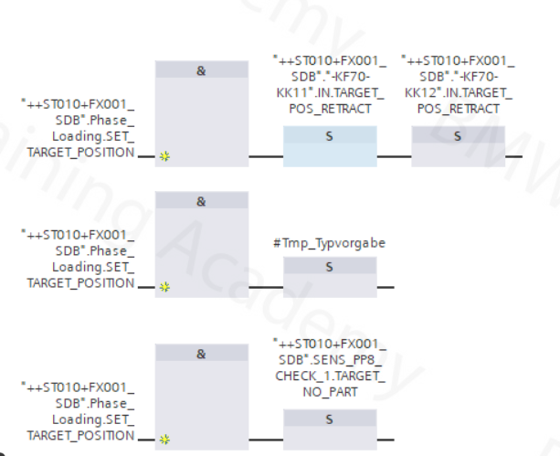
PHASE DEFINITION - ACTUATORS For the complete definition of a phase, the actuator setpoint positions must also be defined:
This definition is relevant for : • the formation of the phases overall basic position. • the animation of the target state of the actuator position in manually guided resequencing.

Slide 7
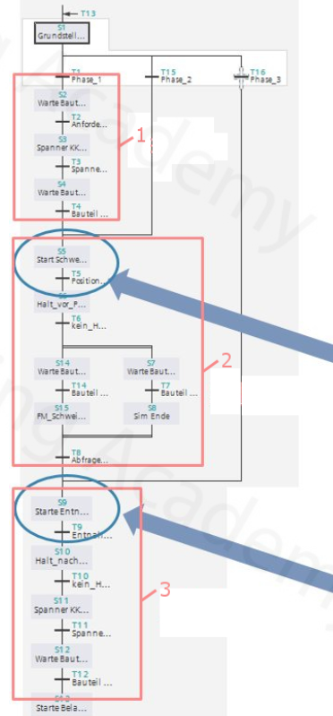
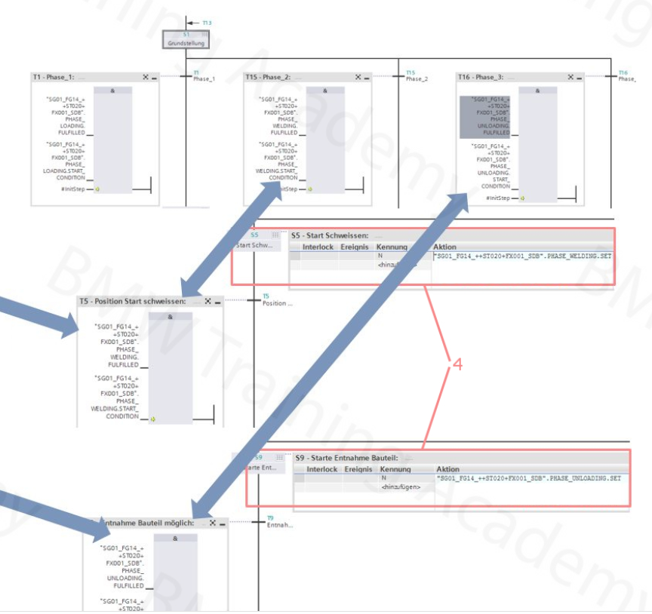
STRUCTURE OF THE SEQUENCER
Description
Phase pick
Phase welding
Phase discard
Set Phase active

Slide 8
STRUCTURE RESEQ SEQUENCER
The resequencing sequencer is always a separate sequencer. The name is almost identical to the normal sequencer, only the extension RESEQ instead of SEQ.
When changing to RESEQ mode, the normal sequencer stops at the last step or the last active steps. however, the output control is suppressed via ZERO_OP.
Only after the RESEQ process has been successfully completed and a phase (including actuators) is reached is the RESEQ chain exited, the normal sequencer initialized and the MAN operating mode switched to.

Slide 9
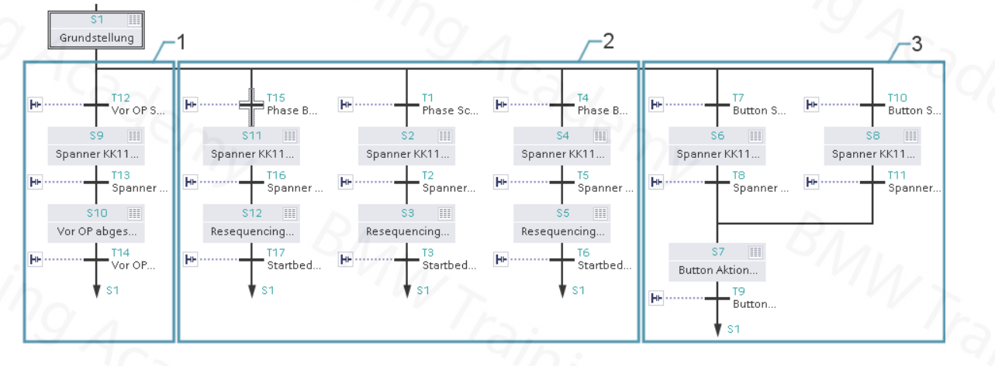
STRUCTURE RESEQ SEQUENCER
Description
Pre Operation
Phases
Button actions

Slide 10
STRUCTURE RESEQ SEQUENCER
The resequencing sequencer is always a separate sequencer. The name is almost identical to the normal sequencer, only the extension RESEQ instead of SEQ.
When changing to RESEQ mode, the normal sequencer stops at the last step or the last active steps. however, the output control is suppressed via ZERO_OP.
Only after the RESEQ process has been successfully completed and a phase (including actuators) is reached is the RESEQ chain exited, the normal sequencer initialized and the MAN operating mode switched to.

Slide 11
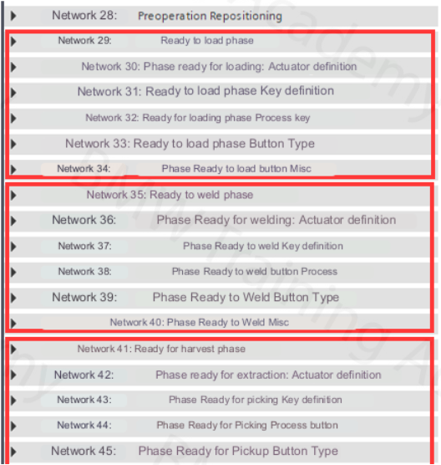
NETWORK STRUKCTURE
There is a fixed block of networks for each phase for the parameterization of all relevant topics:

Slide 12
INTERLOCK PROGRAMMING
There is an interlock bit in the central master structure to enable the resequencing process.
As a rule, resequencing may only be started when there are no longer any robots in the tool, which is why the robots are usually programmed to the interlock.

Slide 14



Contact Us
LINK Group Headquarter
Shanghai, China
LINK Group North China
Shenyang, China
LINK Group Europe (LKGG GmbH)
Bad Reichenhall, Germany
Enquiry
Enquiry
Enquiry
ying.liu@LKautomation.com
kimi.wang@LKautomation.com
jackey.yin@LKautomation.com
+86 021 6918 0161
+86 021 6918 0161
+86 186 2171 9367
Sales
Sales
Sales
gene.zhang@LKautomation.com
gene.zhang@LKautomation.com
andreas.reymendt@LKautomation.com
+86 136 2179 1621
+86 136 2179 1621
Address
BLDG #D,North Jiasong Road No.3570 Jiading District,Shanghai,P.R.China
Address
NO. 14 22nd Floor,NO.168-3 Harbin Road,
Shenhe District,Shenyang,Liaoning
Province,P.R.China
Address
Fischerbraeuwiese 18b,83435 Bad
Reichenhall,Bavaria,Germany

